Slide 1
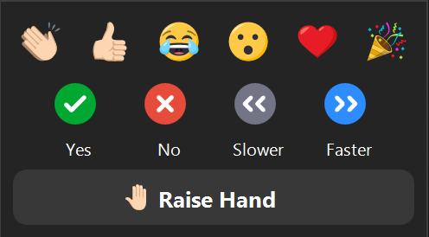
Notes:
Kari
Ask – Click Yes/No icons – Who here has ever done consulting work?

Slide 2
Today’s
Virtual Event
Notes:
Introductions:
Kari’s Intro
Jenn’s Intro

Slide 3
Getting Started as an Independent Consultant
Definitions
Pros vs. Cons
Getting Started
Company Structure
Taxes
Money
Finding Work
Promotion
Billing
Tools &
Resources
Notes:
Jenn
Expectations:
Today’s focus is “getting started”, so if you’re already a consultant, or have years of experience, we look forward to you adding to our discussion.
Review outline on slide.
Was anyone expecting something different?

Slide 4
Survey: What is your definition of an “Independent Consultant”?
Notes:
Kari to ask -

Slide 5
Definitions
Independent Consultant
May or may not “do” the work
Contractor
(“staff augmentation”)
Usually hired to “do” the work
Notes:
Kari to debrief
What is an Independent Consultant?
Own at least part of your own business and is set up as a business (vs a contractor who must work under the banner of another company, such as a recruiter)
Work for multiple companies during each tax year
Have specialized skills or expertise
Work on a temporary, short assignment, or project basis
Work for a client for a limited period of time and not on a permanent basis
Supply most of your own materials and equipment
Has significant decision-making authority over the work they do and how they do it
Consultant vs Contractor?
You may get different definitions and terms used interchangeably but this is our interpretation
Consultant
Analyzes, assesses, offers advice/consulting services for solutions to client problem(s)
May or may not “do” the work
Contractor (aka Staff Augmentation)
Client usually already knows (or things they know) the problem, cause, and solution
Contractor usually hired to “do” the work
Link to IRS regs in Tools & Resources

Slide 6
Pros/Cons
Be your own boss
Work/Life balance
Digital nomadism
Earn more
Test new skills
Start slowly
Test out a company
Liability
Responsibility
Find your own work
Fewer rights
Overhead
You’re an “outsider”
Taxes
Notes:
Kari – Pros
Jenn - Cons
Pros
Become your own boss - Contract work provides greater independence and, for many people, a greater perceived level of job security than traditional employment.
Maintain a good work/life balance - Less commuting, fewer meetings, less office politics – and you can work the hours that suit you and your lifestyle best.
Earn more money - Being a contractor means you get paid for every hour of work you do, at the market rate. If your skills are in demand, your income could be high.
Test out a new field of expertise - Not sure if there's a market for your skills? You can dip a toe into a new industry without committing yourself to a full‐time job. If it doesn't work out, you can cut your losses quickly and easily.
Start on a part‐time basis - This can be appealing to young people just graduating from college, or older people who want to experiment with a second or even third career.
Test out a company - If you're not sure a new company is offering the right full‐time employment opportunity for you, suggest first working for them as an independent contractor.
Cons
Liability
Responsibility
No one is giving you “vacation” days, PTO, sick days – this comes out of your bottom line
No coffee talks/water cooler chats unless you seek them out
Find your own work
Take on other roles - Marketing, Accounting, Project Management
Employment rights – in most countries, you won't have the same legal rights as a regular employee.
You’re only paid for the work you do - You'll have no income during temporary lulls in workload. This can be stressful, so you'll need to budget carefully.
You won’t have employment benefits - Your client doesn't have to provide you with health benefits or even (in some countries) pay you the minimum wage.
You may not be covered by Workers Compensation or similar schemes - It may seem unfair, but you may not be treated on an equal footing with other workers.
The ‘Outsider’ label - You won't ‘belong’ to the organization you happen to be contracting for. They don’t have to invite you to company meetings or involve you in strategy discussions or planning. And some full‐time employees may resent you if they think you're earning more than them.
You may not be covered under equal opportunity employment laws - This varies from one country to another – some governments apply the same legislation to contractors, but many don't.
Taxes are not withheld and paid by your client - This means that if you don't put money aside for your year‐end tax bills, you could get into trouble. Use good quality accounting software to keep track of tax owed and the contents of your savings accounts. Be aware that if your client incorrectly classifies you as an employee, they may be required to pay back taxes and provide employee benefits. That will cause problems for you and your client, so it's important to get it right.

Slide 7
Getting Started
Bookkeeping
Business Structure
Letterhead
IRS EIN/TIN #
Financial Planning
Website or Web hosting
Banking
Logo
Insurance
Business Name
Business Cards
Business Plan
Attorney
CPA
Notes:
Kari – items on the left
Jenn – items on the right
Set up your business - Check out our guide on starting a business for tips on getting registered, choosing a business structure, budgeting and more.
Write a business plan - Be sure to include things such as your rates, expenses and expected growth.
Separate personal and business banking - This makes it much easier to manage your accounts.
Find Company name
Do a search in your state to see if it is available
Do a search for the domain name to see if taken/available
Consider how easy it will be to type, remember, locate
Consider hashtags that would work w/this and if they are already in use
Obtain insurance
Errors and Omissions
General Business Liability
Life Insurance
Health Insurance
Open market
“community plans”
Locate a lawyer/attorney to have on retainer or help with legal matters
It's also a good idea to have your own standard contract, NDA (non‐disclosure agreement), and services agreement for your clients to sign.
Some clients may prefer to use their own documentation.
Get IRS EIN/TIN #
Get a PO Box if you don’t want your home address used
Hire an accountant, CPA, Financial Planner and/or maybe bookkeeper (or, a registered agent)
Consider a SEP IRA
If S-Corp or C-Corp, consider 401K as an employee of your own company that matches PLUS an additional IRA or Roth
Bookkeeping
Choose a good quality bookkeeping method (software or Excel sheet)
Some examples are: FreshBooks (free to start), QuickBooks, KPMG Spark, Sage
Use it to track expenses, send out invoices and reduce your end‐of‐year tax work.
How will you number your invoices
How will you track spending, income, taxes paid; how will you report it?
What will your late payment policies be?
Consider expenses (tracking, keeping, etc.) – how much can be written off?
NOTE: Tax write-offs are NOT what you think!
Logo, Letterhead, Business Cards, etc.
Kari hired someone on Fiverr for $20
Consider what it will look like on black, white, and all other colors
Consider paying for a grayscale option as well
Used Word and added logo in header
VistaPrint super easy
Website & Web hosting
Used Wordpress.org, can use Wordpress.com, Wix, don’t spend too much time here
Buy your domain name!
Email setup – We both pay for Gmail for business $5/mo w/our domains
Domain fee (annual?)
Social media accounts – separate your personal from your business!

Slide 8
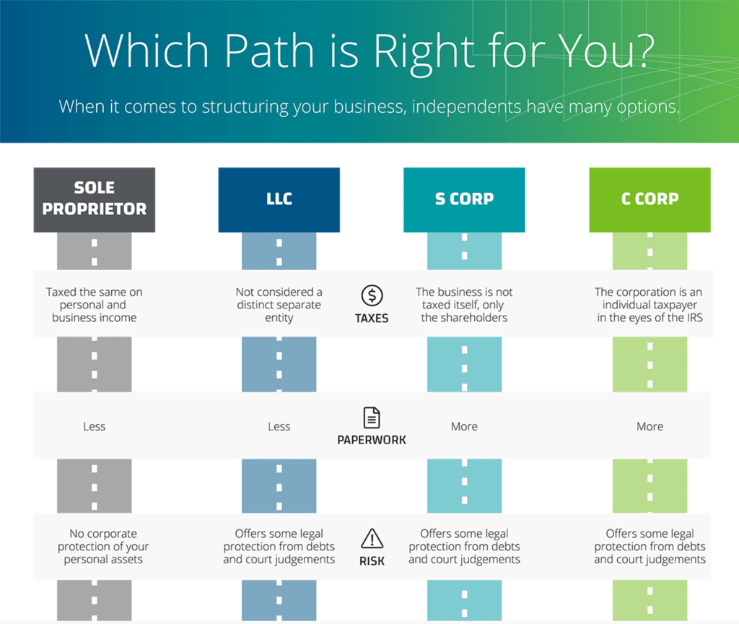
Company Structure
Notes:
Jenn
Disclaimer: Talk to the following people: an attorney, a CPA (or a tax attorney), a financial planner
This graphic summarizes the different company structures that are available to you. Each have their pros and cons and it’s important to understand the differences. Also, depending upon which state you live in, you might have other options or hybrid options to consider
Do your research, talk to your colleagues and networks to find out what they did and why they went that specific route. As always, talk to an attorney, a CPA (or a tax attorney), and/or a financial planner to determine what is right for you.
Generic Order of what to do when:
LLC/S-Corp/C-Corp/Sole Proprietor - drop the app, takes 1-3 business days to process (only true for new businesses) then...
EIN - is immediate
Tax license w/ County - same day (this lets you legally claim part of your house as WFH deductions)
Business Insurance - usually same day

Slide 9
Company Structure: Jenn vs Kari
 | J Buckley Consulting, LLC | Instructional Design Studio LLC
Legal Structure | LLC | LLC
Est Date | 2010 | 2016
Est State | Florida | Delaware
Tax Structure | single member LLC “disregarded entity” | 2016 – single member LLC 2017 – elected S-Corp w/IRS
Fees (approx.) | $125 fee to start $140/year to Florida | $90 fee to start $300/year to Delaware $45/year for Reg Agent
Taxes | Pays quarterly tax payments Completes Schedule C for business income (annual) Income flows to 1040 from Sched C | Pays taxes monthly on payroll taken Files quarterly paperwork w/IRS Takes dividends at year end if able S-Corp files 1020S which generates K1 Income flows to 1040 from K1
Notes:
Kari
There can be significant differences even with the same type of company structure! Each situation is unique to each person’s situation.
Even while we were creating this presentation, we learned things different about how we each do business, pay taxes, so it is VERY important that you do your own research.
Quick run-through of Jenn vs Kari – two LLCs that are NOT the same!

Slide 10
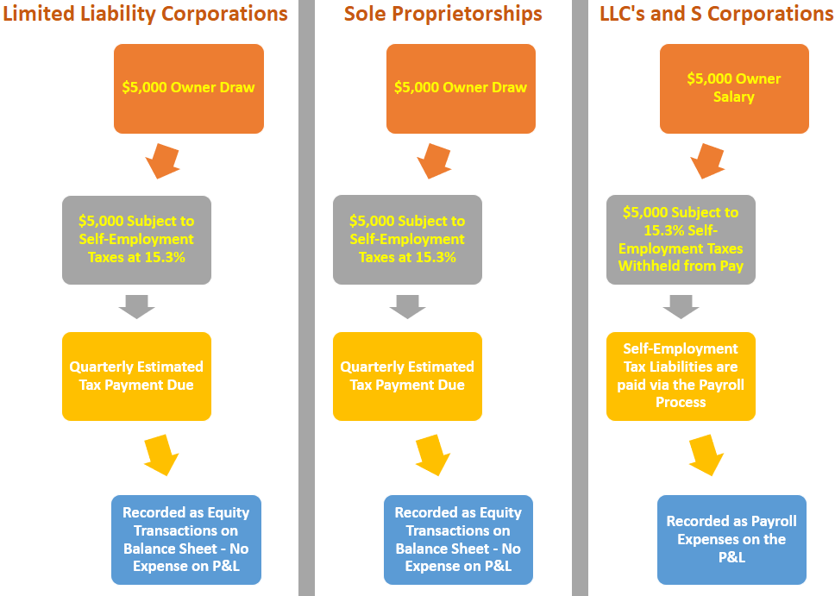
Let’s talk about Taxes!
Notes:
Jenn
Taxes
No matter what type of organization you are, tax payments are required.
When you are a W2 employee, the company you work for is sending in FICA (Federal Insurance Contributions Act) which pays for Medicare, Social Security, disability, and unemployment on your behalf to the IRS. In addition, the company you work for pays for roughly half of FICA as the “employer” and you pay half as the “employee”. Also, the employer makes regular FICA payments to the IRS throughout the year. The IRS wants their share as soon as it is earned.
When you are self-employed, it is your responsibility to send in those taxes to the IRS so you will need to establish yourself with the IRS. Not only that, but you will have to pay both the employee AND the employer portions. This add up to an estimate of $.32 cents of every dollar. Add to this the fact that you should make payments to the IRS throughout the year to avoid any penalties. Why? Well, now that you are your own “employer”, it is now your responsibility to pay the IRS as soon as you earn your money so they can get their cut. Luckily, the IRS isn’t totally heartless – they allow you make quarterly installments.
We recommend taking 30% from every check and putting it into your business savings account. Use this to pay taxes. You will need to talk w/your accountant on specific details. (Jenn actually recommends 35%-40% to allow for any unexpected issues. If there are no unexpected issues, then you have the beginning of a nice vacation fund!)
(Kari) LLC taxed as passthrough – I had to sign up w/EFTPS so I could electronically send the IRS quarterly payments on the amount of money I projected I would make (sales – expenses) for the year.
(Kari) I also have heard from some who just use their business credit card or bank account to rely on categorization of expenses and hand that to their accountant. (Notice that an actual “accountant” is in this scenario!)
(Jenn) I second using EFTPS – it’s quick, it’s easy, and you can set up your payments in advance. For example, let’s say the September 15th payment date is during your vacation and you flat out refuse to take your laptop with you (good for you!). That’s ok, you can either pay early or set up the payment to draft from your bank account on the day of.
Get an IRS EIN/TIN #
Here’s why you NEED this… (and, it’s free!)
As a consultant or contractor, you will fill out a LOT of W-9’s and these require your social security number. However, you don’t want your SSN all over the place. An EIN/TIN protects your SSN because you use the EIN/TIN in place of your SSN. When you pay taxes, you use the EIN/TIN and the IRS matches up your EIN/TIN with your SSN on their end. So, as a taxpayer, you’re protected.
With the flexing of income, it's MUCH easier to be an LLC than an S Corp (certainly, the tax prep is easier: Form 1040, Schedule C, Schedule SE).
The IRS has a set of guidelines called "Safe Harbor" that is specifically designed for LLCs and individuals but doesn't help S Corps at all.

Slide 11
Quick Easy Rule of Thumb to Estimate Taxes
 | Independent
Rate | $60 /hour
30% Est | 30% $20 /hour
Net Pay | ($40 /hour)
Notes:
Jenn
We recommend taking 30% from every check and putting it into your business savings account. Use this to pay taxes. You will need to talk w/your accountant on specific details.
(Jenn actually recommends 35%-40% to allow for any unexpected issues. If there are no unexpected issues, then you have the beginning of a nice vacation fund!)

Slide 12
Let’s talk Money!
 | Employee | Independent
Salary | $50,000 /year ($24 /hour) | $50,000 /year ($24 /hour)
FICA | 7.6% $5,040 | 15.3% $10,080
Biz Insurance | $0 | $450 /year
Overhead/ Expenses | $0 | $5,000 / year
PTO/Sick | $0 | $2,120 (10 days off)
Net Pay | $44,960 ($21.60 /hour) | $32,350 ($15.55 /hour)
These are estimates
These numbers can drastically change based on your tax structure, tax filing status, and so much more
Doesn’t include Health Insurance, Retirement funding, or other taxes (state, local, sales)
Notes:
Jenn
Earning Potential - Employee vs Independent Consultant
As an employee, if you earned 50K as a W2 - rough estimate, you earned $24/hour including PTO, vacation, sick time, health benefits, retirement, etc.
As an independent consultant, you pay ALL the taxes. Assuming those are $10,080, let’s increase the hourly rate to cover that tax bill ($26.50/hour or $55,120). At $26.50/hour, that will cover your taxes but… You have business insurance to pay, overhead (software, computer, office supplies, internet, phone bill, etc.), and if you want a vacation or take a sick day for doctor’s appointments, that needs to be factored in as well. And then there’s your retirement fund to consider. Suddenly, that hourly rate that was increased just to cover taxes, doesn’t cover enough!
RULE OF THUMB - Even if you were to get a gig of $60/hour you may think you are getting paid double but not so fast. Take 30% off the top to account for health insurance, retirement, business insurance, overhead, and taxes and you get $40/hour. You NEED to earn more per hour as a independent contractor than as an employee to make it worth it

Slide 13
What to Charge?
1099
W2
Higher rate
$50/hour
Responsible for paying ALL taxes and overhead
Employer manages most of your taxes
Lower rate
$35/hour
Notes:
Jenn
About Pay Rates
How do you know what to charge? A lot depends upon the type of work and the level of complexity. 1099/Corp-to‐Corp (C2C) gets a higher hourly rate but you pay 100% of the taxes and it's about 32% for Federal (in states like NY you’ll need to factor in local and state taxes). As a W‐2, through a recruiter, you'll get a lower hourly rate but they pay half the taxes.
Let’s say, there’s an instructional design project, and you’re being offered $50/hour as a 1099/C2C or $35/hour as a W2. How do you know if this is “fair”? Check the latest salary surveys to see which positions are closest to what’s being asked for and extrapolate from there. In general, if the request is for a blended role (ex. a Project Manager and an ID), go with the higher rate. ATD, the Learning Guild, Training, STC, PMI, and ISPI are good places to look for data. Checking with your local ATD chapter to see what they might have for their area and/or region is also helpful.

Slide 14
Finding Work
Specialized Websites
Government‐run procurement sites
Networking
Recruiters
Professional Associations/Groups
Your Network
Notes:
Kari
1. Specialized websites - Companies post projects for individuals to bid for on sites such as Upwork.
2. Government‐run procurement sites - Mainly for public sector projects, these can be useful for finding contract work. Governments require several steps for you to become a supplier.
3. Networking -
Social media sites, especially LinkedIn - Use your connections to learn what businesses are looking for – and bid when they announce invitations to tender.
Your contacts- Reach out to your friends and see if they know of anyone who needs assistance at their companies.
Other contractors - Your skills might be complementary to theirs, allowing you to form a loose consortium of contractors who can refer work to each other. If what you make or do can be delivered online or by mail, you can broaden your search to other countries. Good accounting software will make it easy to invoice in different currencies.
Professional associations/online groups. Get involved
Training Pros
Cheryl Manning, (727) 363‐1446, cheryl.manning@training‐pros.com
The Training Associates
Todd Thistle, (508) 890‐8658, TThistle@ttacorp.com
Clarity Consultants
Kathy Dedek, kdedek@clarityconsultants.com
Corporate Brokers ‐ these guys specialize in L&D and are based in MD & FL
Jared Drymond, (407) 675‐5209, jdrymond@corporatebrokers.com
Alex Kelly, (407) 675‐5210, akelly@corporatebrokers.com
Consultis
Bill Hodges, (813) 286‐7860 x111, billh@consultis.com
Adecco
Brett Forrest, (813) 287‐5511, brett.forrest@addecona.com

Slide 15
Promotion
Utilize social media
Add/provide value
Get involved
Reach out to your contacts
Professional groups
Notes:
Kari
Social media sites, especially LinkedIn - Use your connections to learn what businesses are looking for – and bid when they announce invitations to tender.
Your contacts- Reach out to your friends and see if they know of anyone who needs assistance at their companies.
Professional associations/online groups. Get involved
Adding/Providing Value
Getting involved

Slide 16
Survey: What do you do?
Notes:
Kari

Slide 17
Survey: What have you seen in social media that caught your attention?

Slide 18
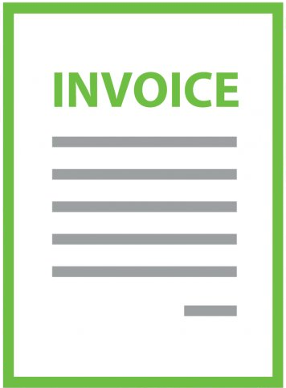
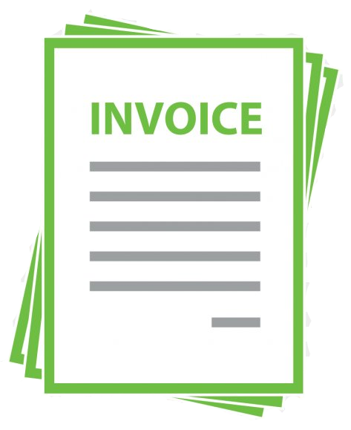
Billing
$/Project
$/Hour
Notes:
Jenn
Project Rate vs. Hourly Rate
Do you charge by the hour or by the project? This depends upon many factors – trust being the most important one - but one thing I’ve learned is that charging by the hour and submitting invoices weekly or bi-monthly makes it less likely to end up with a deadbeat client. When charging by the project, it’s incredibly important to have both a contract and a well defined Scope/Statement of Work (SOW) that includes regular reviews of work in progress, deadlines, and a process for change requests. Also recommended is billing by phase so that should the client back out, it won’t be at the very end when you’ve invested hours of time and effort that you won’t be able to recover from.

Slide 19
Tools & Resources
What is an LLC?
TechInsurance
IRS Safe Harbor Rules (1)
Chapman Alliance: Estimating Tools (S28 & 29)
Florida LLC Forms
FreshBooks
IRS Safe Harbor Rules (2)
Christy Tucker:
ID Hourly Rates
LLC vs S-Corp (1)
Freelancers Union
IRS Self-Employment Taxes
Elearning Guild:
2018 Salary Report
LLC vs S-Corp (2)
QuickBooks
IRS EIN Online
ATD:
2019 Salary Report
LLC vs S-Corp (3)
Estimating Learning Projects
IRS TIN Online
PMI: Salary Report
Business Structures
Estimating Writing Projects
IRS Self Employed Retirement Options
ISPI
Tax Structures
Mastering the Elevator Pitch
IRS SEP FAQs
Notes:
Jenn/Kari

Slide 20
February Events
Notes:
Kari

Slide 21
Share Your Reflection
https://forms.gle/5v4pyALUR74Nyv167
Notes:
Kari

